Slide 2


Slide 3
MixMAs: AN AUTOMATED ANALYSIS OF SINGLE PARTICLE TRACKING DATA FOR PROTIENS THAT EXHIBIT MULTI COMPONENT MOTION
Rehan Ali
Notes:
Change arrows
Talk about Matlab

Slide 4
An overview of the presentation, aims of different sections
Section 1: Why do we need to analyze motion of particles in the context of axonal transport?
Section 2: How do we analyze motion of particle?
Section 3: A novel tool for analysis of motion of particles.
Section 4: A tool that has a wide range of applicability and is not limited to the study of axonal transport.

Slide 5
Section 1: Why do we need to study motion of proteins involved in axonal transport

Slide 6
Axonal Transport: from cell body to the axon terminal and vice versa, a challenge for neurons
Transport proteins
But why is this a challenge?
Axon
AXON TERMINAL
Where proteins are needed
CELL BODY
Where proteins are formed
Kandel, 1995, Lodish H, 2000

Slide 7
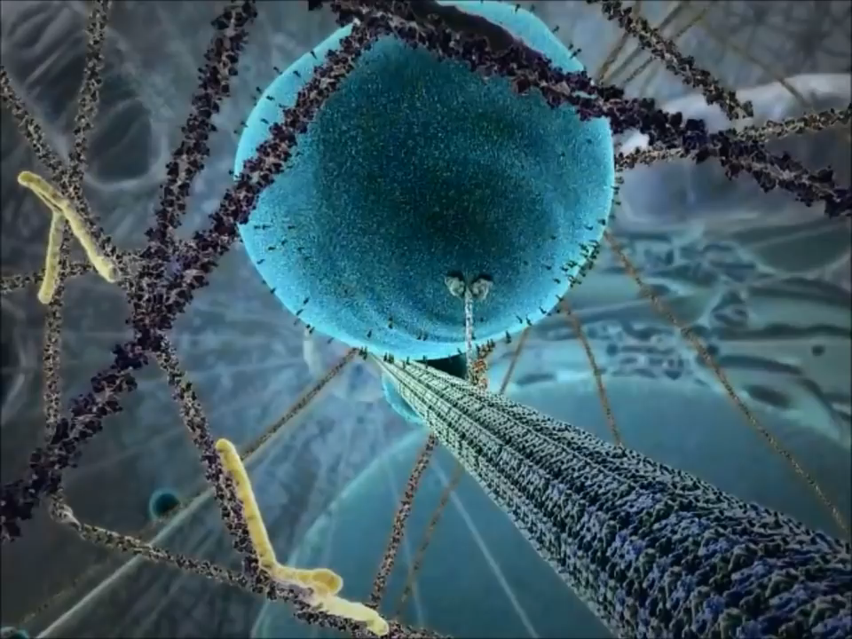
A simplistic view of axonal transport
But even in this simplest of models, the crowded environment can be observed.
https://www.youtube.com/watch?v=y-uuk4Pr2i8

Slide 8
Maday et al., 2014, Svoboda et al., 1993,
http://livehealthy.chron.com/average-walking-stride-length-7494.html
Let’s do some calculations:
Step size of motor = 8nm
Axon length range: < mm to a meter long.
For an axon of length 5mm, the number of steps a motor takes = 62500
Average men step size = 2.5 feet
How long will a man travel with this number of steps?
But why is this a challenge?

Slide 9
Maday et al., 2014, Svoboda et al., 1993,
http://livehealthy.chron.com/average-walking-stride-length-7494.html
Let’s do some calculations:
Step size of motor = 8nm
Axon length range: < mm to a meter long.
For an axon of length 5mm, the number of steps a motor takes = 62500
Average men step size = 2.5 feet
How long will a man travel with this number of steps?

Slide 10





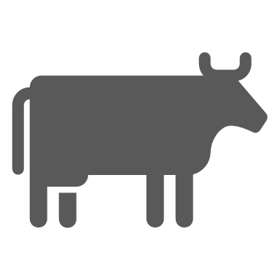





From New York to Boston, a challenge for humans
Hurdles
If you are waiting for food delivery what do you care about the most?
Tony’s motion!
Food Source
Transporter (Tony)
Path
Food Required

Slide 11
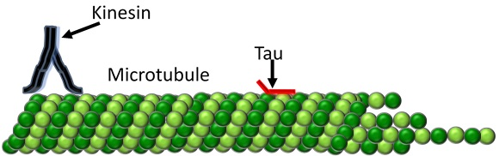
Kinesins walk on microtubules to transport cargo
Hirokawa, 1998,
Vale et al., 1985,
Weingarten et al., 1975
Just like our analogy ‘from New York to Boston’ we need to study Kinesins motion
(‘Transporter’)
(‘Path’)
(‘Regulator’)

Slide 12
A simple experiment: let’s look at kinesin’s motion
1- Velocity
2- Distance travelled (run length)
Displacement
Time
https://www.youtube.com/watch?v=y-uuk4Pr2i8

Slide 13
Let’s extend our experiment: add Tau to the system
Tau is a Microtubule associated protein, which means that it binds microtubules, more about it later

Slide 14
Displacement
Time
What will Tau do?
Will this motion profile change?

Slide 15
Analyzing Kinesin motion informs us about Tau’s function
Analyzing Kinesin motion informs us about Tau’s function
Kinesin’s motion becomes multi component
Kinesin-1, no Tau
Kinesin-1 with Tau
1- Velocity
2- Distance travelled (run length)
Encounters Tau
1- Velocity
2- Distance travelled (run length)
3- Pause duration
4- Number of pauses
Displacement
Displacement
Time
Time
Seitz et al., 2002, Vershinin et al., 2007, Dixit et al., 2008, Vershinin et al., 2008, McVicker et al., 2011, McVicker et al., 2014

Slide 16
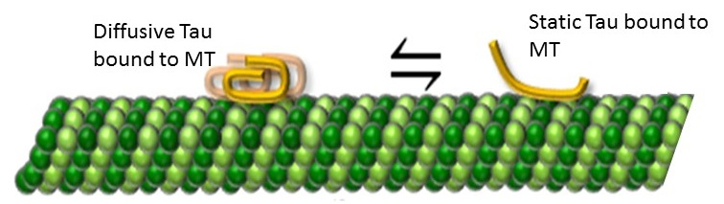
Tau also shows motion with multiple components
But why do we care about Tau’s motion?
Mercken et al., 1995, Konzack et al., 2007, Hinrichs et al., 2012

Slide 17
State of equilibrium between components of motion of Tau determines Tau’s ability to inhibit Kinesin-1
Kinesin-1
Kinesin-1
Encounters Tau
-3RS
Encounters Tau
-4RL
Analyzing Tau’s motion informs us about Tau’s ability to inhibit Kinesin-1
Tau’s motion has multiple components
Displacement
Displacement
Time
Time
Dynamic
Static
Dynamic
Static
McVicker et al., 2011, McVicker et al., 2014,
Stern et al., 2017

Slide 18
What have we established so far?
Transport of cargo within an axon is a complex process, and from a scientific and health perspective, it is an interesting phenomenon for us to investigate.
Analyzing motion of proteins involved in this transport informs us about the function that these components play and,
increases our understanding of axonal transport.
Motion of these proteins is multi component.
Therefore
We need to analyze the multi component motion of Kinesins and Tau to understand the process of axonal transport

Slide 19
Section 2 : How do we study motion of single particles

Slide 20
Steps required for analyzing motion of a single particle
1- Take images of particles of interest at different time points.
2- Track particles in those images to get their position at different points.
3- Analyze the trajectory of motion obtained from tracking of the particles.
Single Particle Tracking (SPT)
Notes:
Table of tracking programs

Slide 21
Schematic of an experiment to image single particles
Fluorescent tag
Kinesin motor
Excitation light from microscope
Thompson and Lagerholm, 1997; Pierce and Vale, 1999; Gustafsson, 2000; Schmoranzer et al., 2000; Toomre and Manstein, 2001; Betzig et al., 2006; Willig et al., 2006b; Willig et al., 2006a; Kellner et al., 2007; Willig et al., 2007; Schermelleh et al., 2008, Adams et al., 2002; Andresen et al., 2004; Chen et al., 2005; DeRocco et al., 2010; Campos et al., 2011; Benke et al., 2012; Shank et al., 2013; Raeisolsadati Oskouei and Brouwer, 2017
Notes:
X-y coordinates of a motion profile

Slide 22
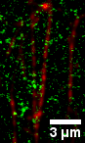
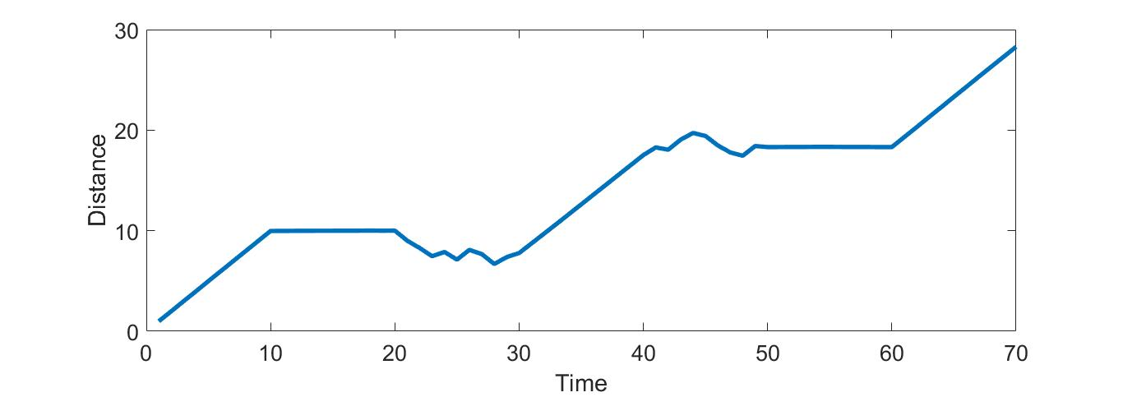
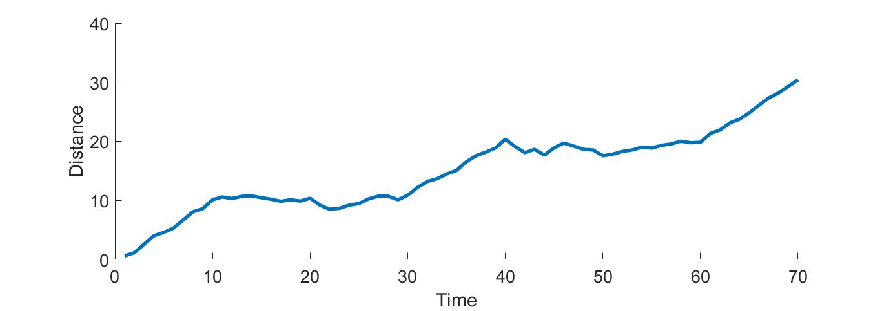
Let’s look at the generated image and it’s SPT data
Manual ‘labor intensive’
A lot of time spent on
something mind numbingly dull ‘time intensive’
Subjective
Error = ‘Localization Error’
Alexa488: Tau, TRITC: MTs
Courtesy “Jamie Stern”
Notes:
The need for an analysis tool

Slide 23
The tool that we need
Automatic ‘less labor intensive’
‘time efficient’
‘Objective’
‘User friendly’
Manual ‘labor intensive’
A lot of time spent on
something mind numbingly dull ‘time intensive’
Subjective
Notes:
Numerous slides

Slide 24

Be happy…..
We are half way through!

Slide 25
Section 3 : MixMAs, an automated, time efficient, user friendly tool for analysis of SPT data for particles with multiple components of motion

Slide 26
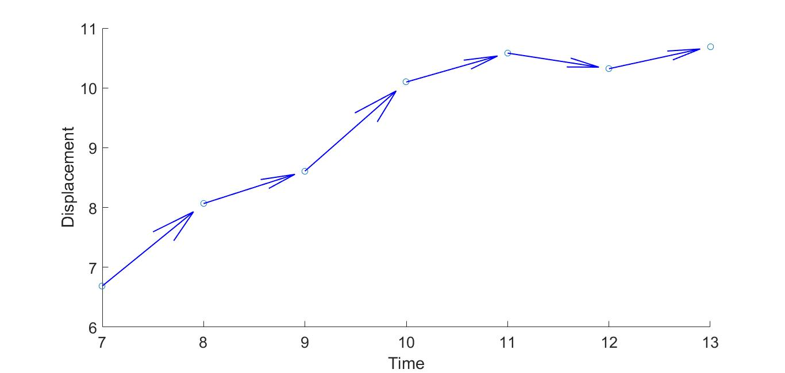
The sliding window approach
S²
θ²
1- Movement parameter = Maximum(S¹ & S²)
2- Direction parameter = Standard deviation (θ¹ & θ² )
2
S¹
θ¹
1

Slide 27
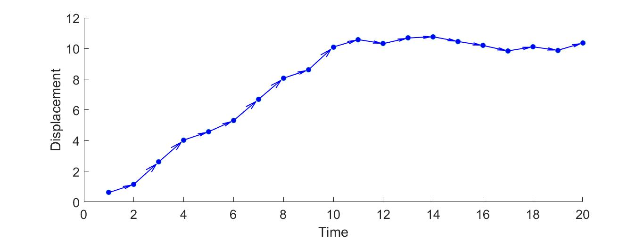
Distinguish between dynamic and static components
M11
M12
M13
M3
Movement parameter (M) > Movement cutoff:
Component = dynamic
Otherwise:
Component = static
M2
M1

Slide 28
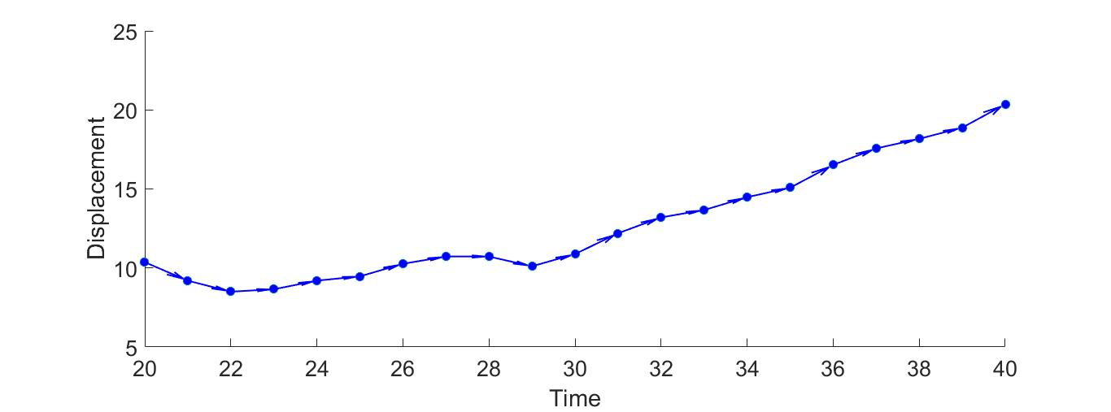
Distinguish between diffusive and directed components
Direction parameter (D) < Direction cutoff:
Component = directed
Otherwise:
Component = diffusive
D13
D12
D11
D1
D2
D3

Slide 29
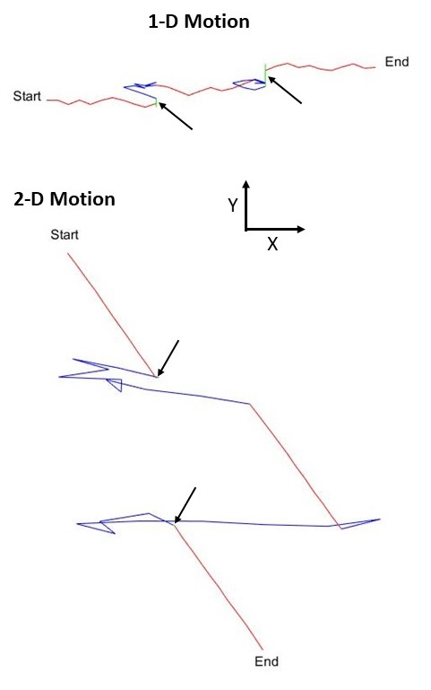
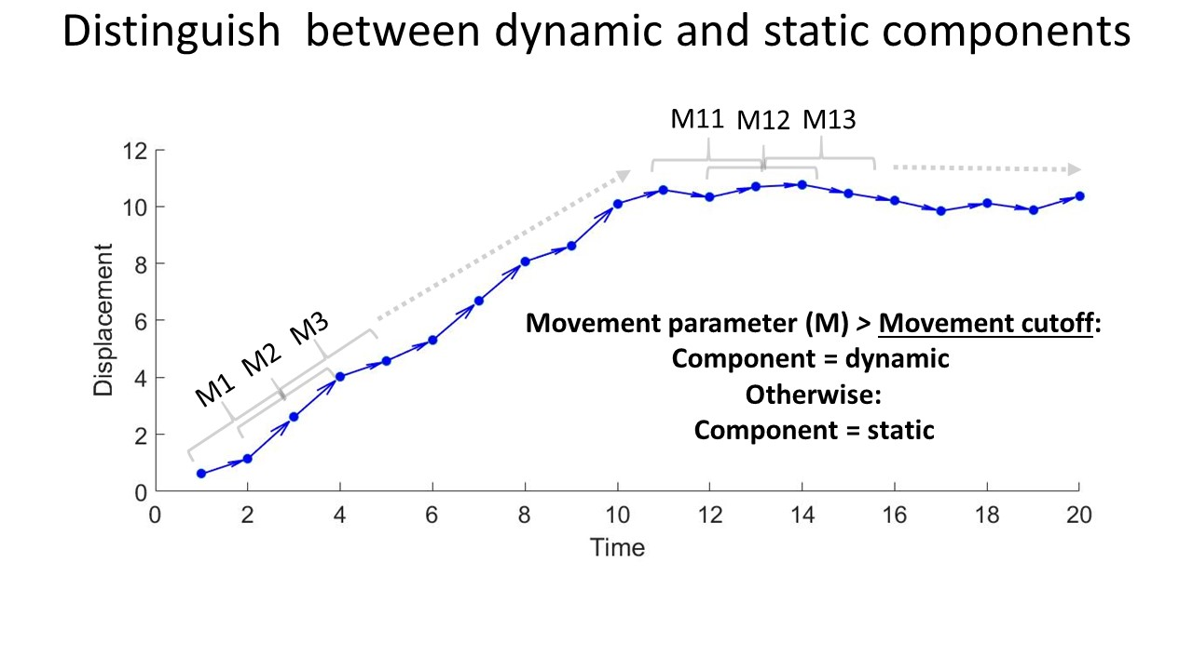
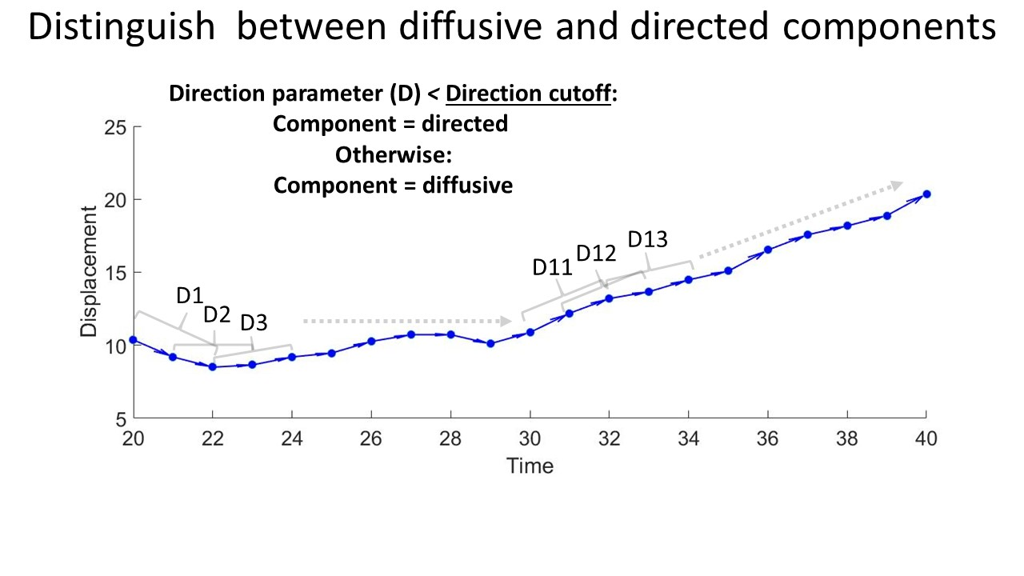
Simulations are amazing!
1- How to determine ‘movement cutoff’ and ‘direction cutoff’?
2- How do we validate the working of MixMAs?
Red = directed
Blue = diffusive
Green = static

Slide 30
1- How to determine ‘movement cutoff’ and ‘direction cutoff’?

Slide 31
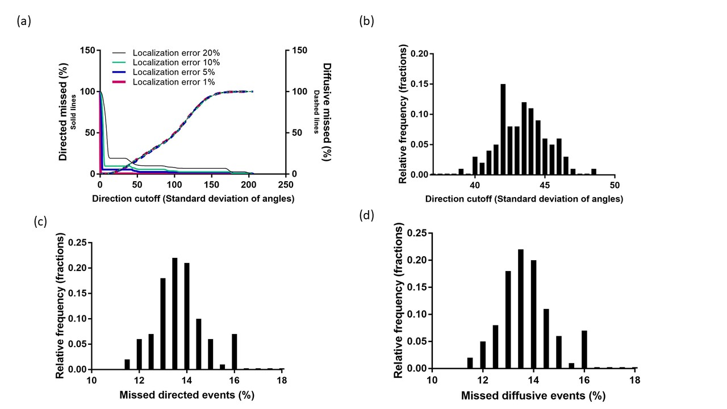
Just need an estimate of ‘localization error’ and ‘step size’
Localization error % = (error/1) x 100

Slide 32
1- How do we validate the working of MixMAs?

Slide 33
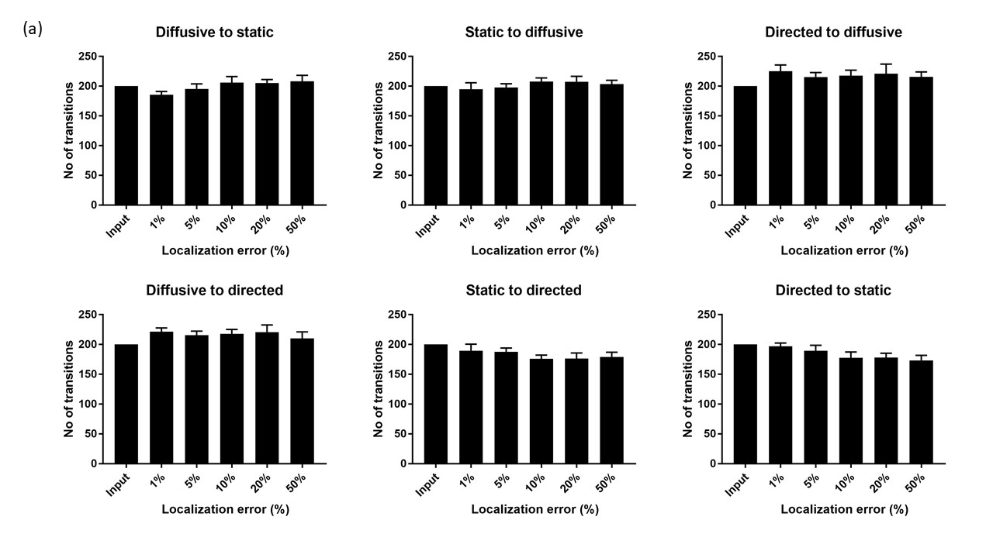
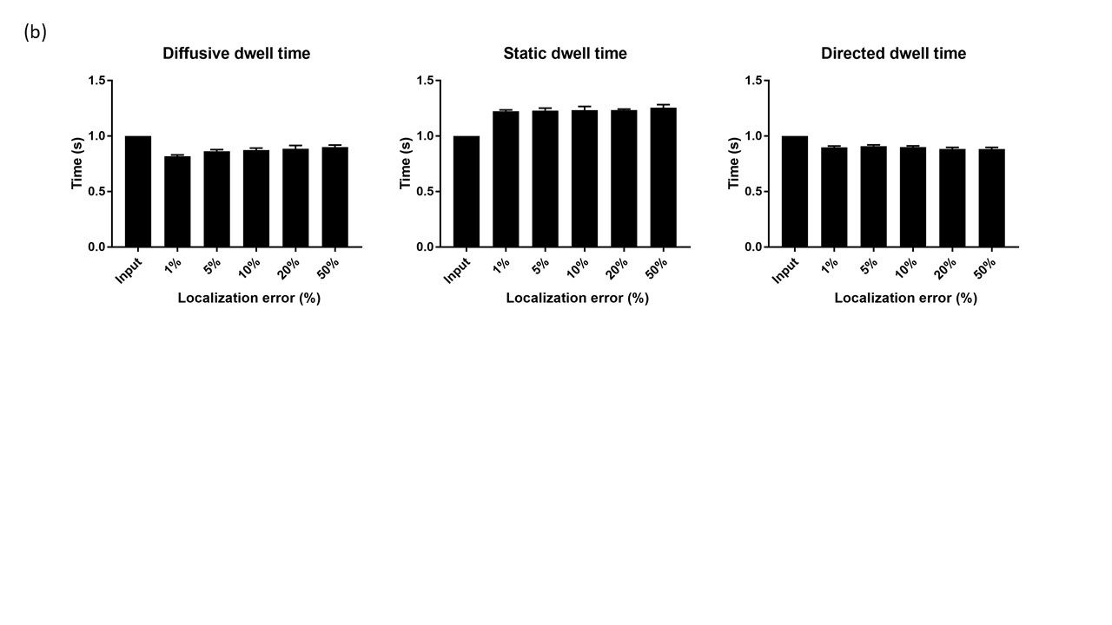
Simulations validate the working of MixMAs for a range of localization errors (1-D)
Localization error % = (error/1) x 100

Slide 34
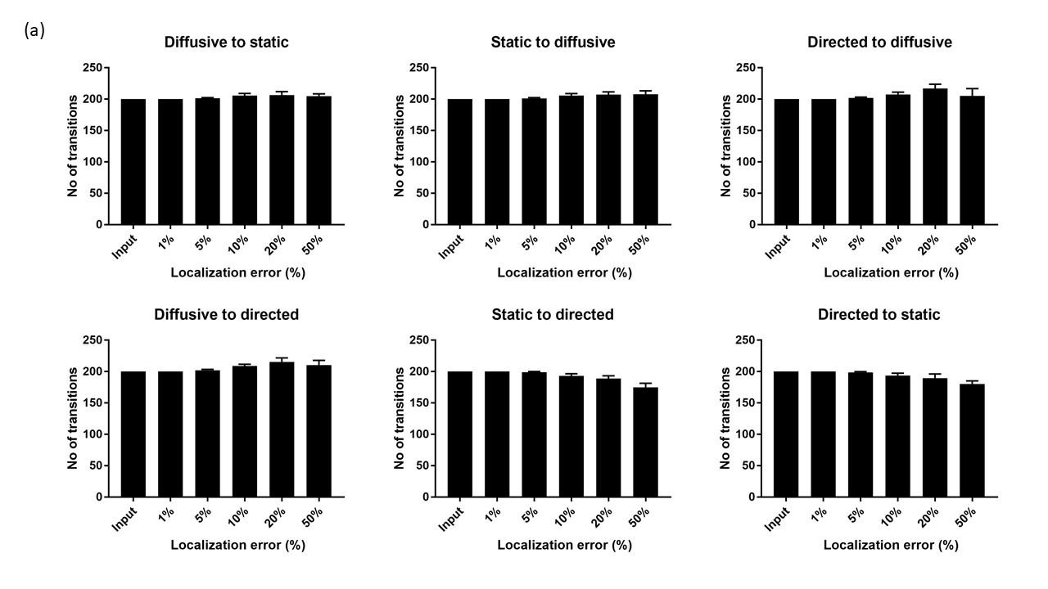
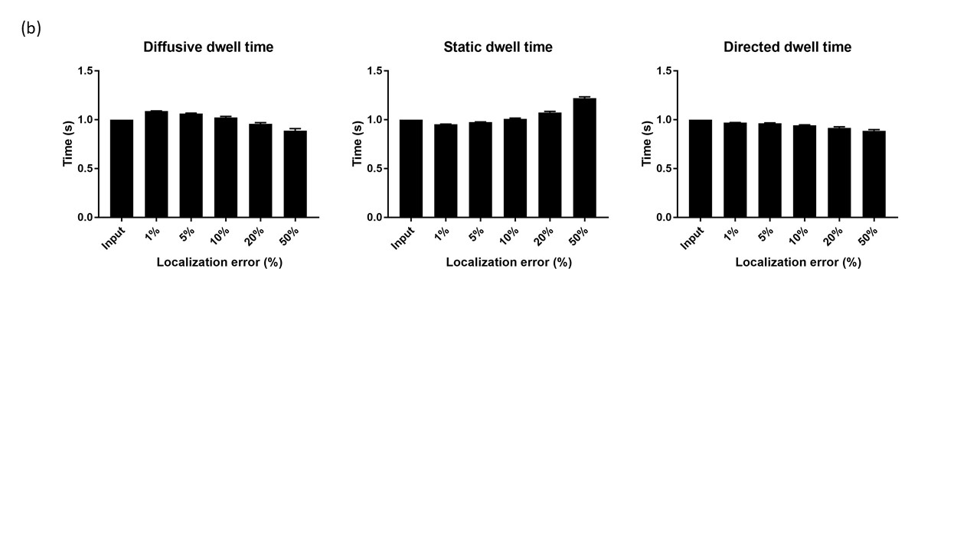
Simulations validate the working of MixMAs for a range of localization errors (2-D)
Localization error % = (error/1) x 100

Slide 35
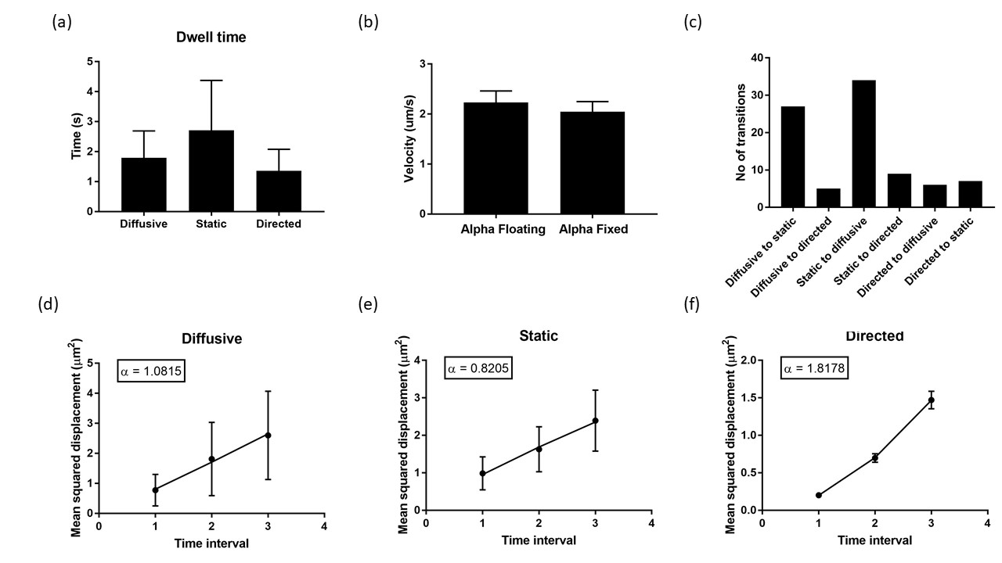
Application on experimental data for Kinesin-3 (‘Courtesy Dominique Lessard’)
α = 1 : diffusion
α = 2 : directed

Slide 36
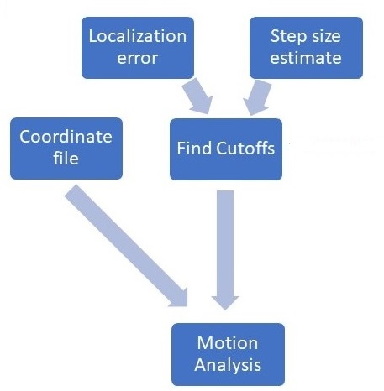
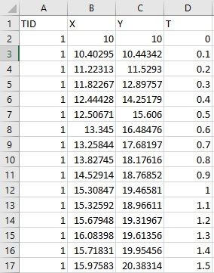
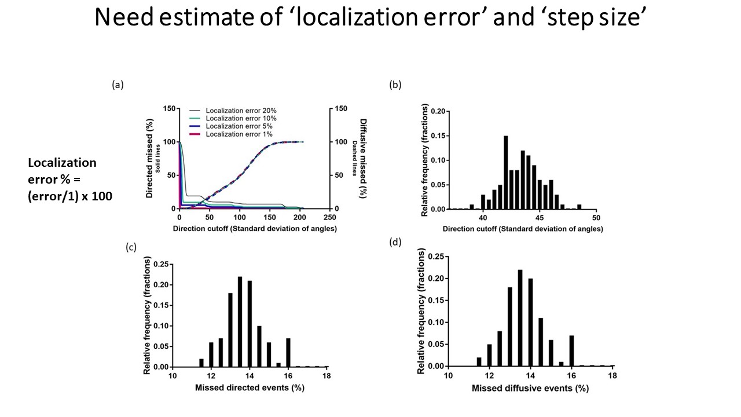
OK! now I know how it works and it’s also validated but how do I use it!

Slide 37
OK! now I know how it works and it’s also validated but how do I use it!
Let’s see it in action!
MatlabExample2.mp4

Slide 38
The tool that we need and now have ‘MixMAs’ is
Automatic ‘less labor intensive’
‘time efficient’
‘Objective’
‘User friendly’
Notes:
Numerous slides

Slide 39
Section 4 : MixMAs is not limited to just analysis of SPT data of proteins involved in axonal transport

Slide 40
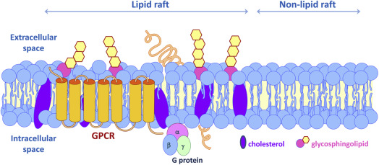
Biological membranes are fluid and non-homogenous
Membrane fluidity important for:
Protein trafficking, cell signaling etc.
Pralle et al., 2000, Schutz et al., 2000, Holthuis and Menon, 2014, Ge et al., 2001, Van et al., 2016
Notes:
Lipid bilayer basic

Slide 41
SPT is one way to measure membrane fluidity
Quantify fluor-tagged particle’s motion
Schutz et al., 2000, Eggeling et al., 2009, Sahl et al., 2010, Vicidomini et al., 2015)
Notes:
Lipid bilayer heterogenous

Slide 42
Use MixMAs to study membrane fluidity or any other particle’s motion!
Soon MixMAs will be on GitHub, and hopefully many will use it as an aid for analysis of motion with multiple components
Notes:
Application of MixMAs to membrane fluidity

Slide 43



Acknowledgements
Berger Lab:
Christopher Berger
Lynn Chrin
Jamie Stern
Alisa Cairo
Dominique Lessard
Gregory Hoperich
Stumpff Lab:
Jason Stumpff
Cindy Fonseca
Heidi Malaby
Haein Kim
Leslie Sepaniac
Alex Thompson
CMB Administrations:
Haley Bradstreet
Jessica (Deaette) Lalime
OIE:
Evan Mills
NGP Students:
Roman Popov and Mila
James Bishop
Estellie Spear
NGP Chair:
Anthony Morielli
Miscellaneous:
Dr. Ann Clegg
My Family!
Notes:
Put doctors name.

Slide 44
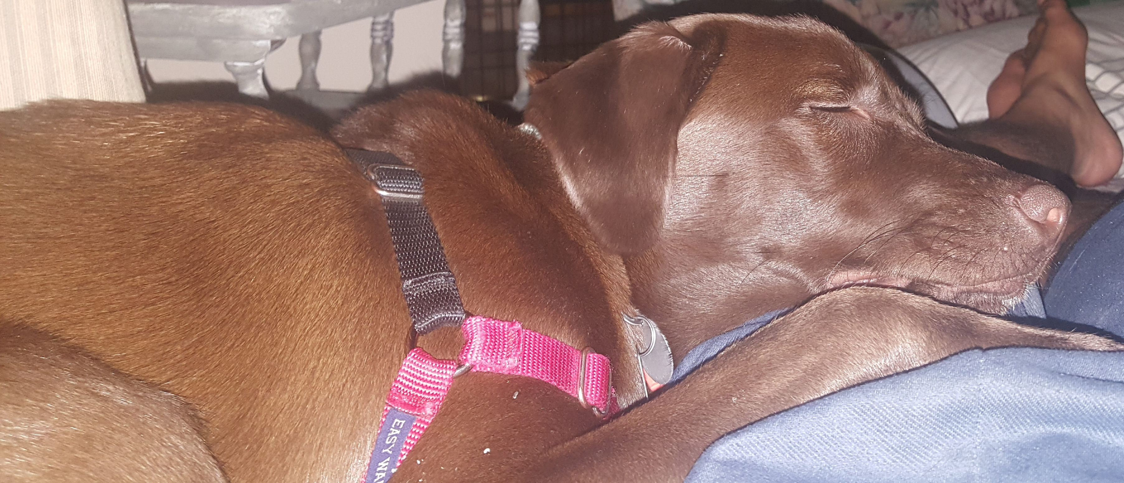
Acknowledgements

Slide 45
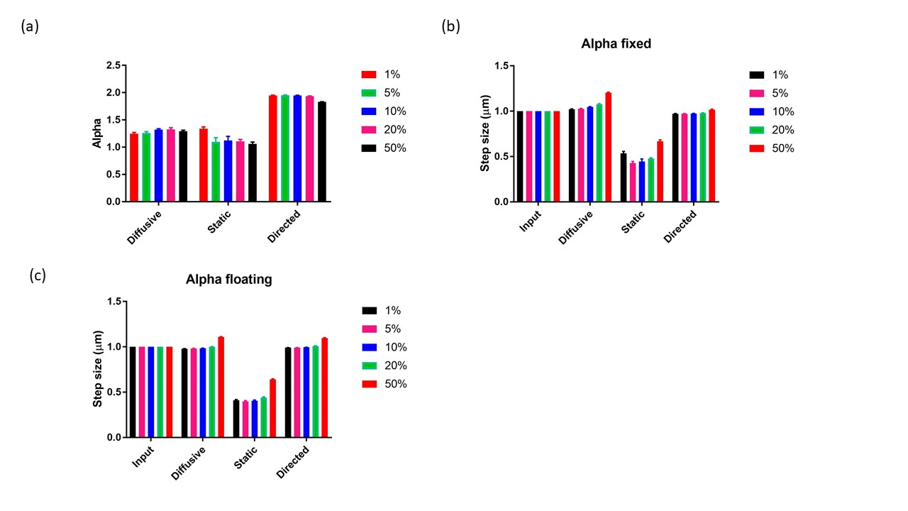

Slide 46
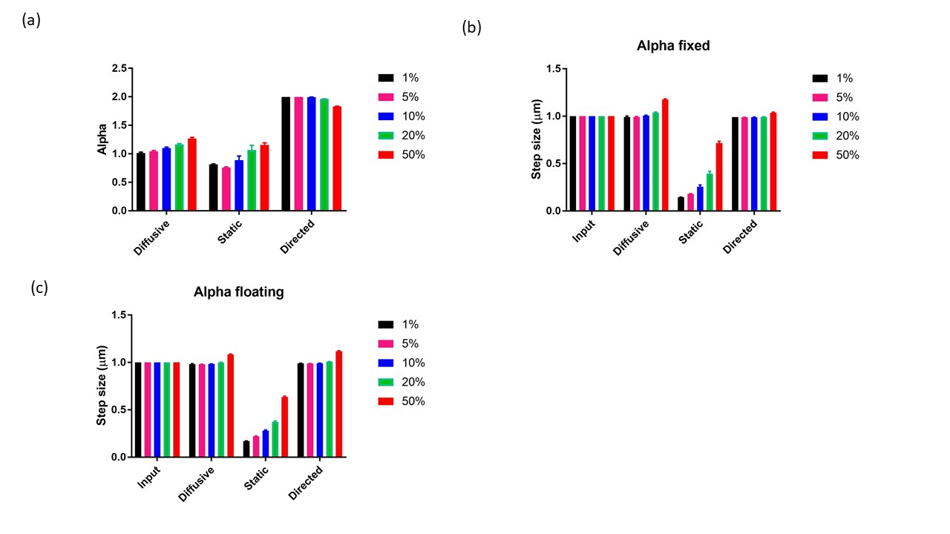

Slide 47
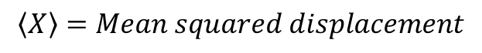
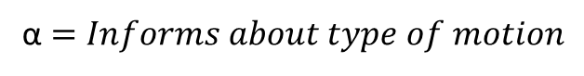
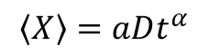
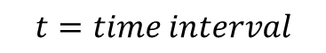
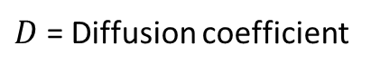
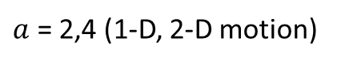
$$〈X〉=aDt^{α}$$
$$〈X〉=Mean squared displacement$$
$a$ = 2,4 (1-D, 2-D motion)
$D$ = Diffusion coefficient
$$t=time interval$$
α$=Informs about type of motion$
$$MSD\left(1\right)= mean(distance \left(1 to 2\right)^2+distance \left(2 to 3\right)^2………)$$
$$MSD\left(2\right)= mean(distance \left(1 to 3\right)^2+distance \left(2 to 4\right)^2………)$$

